Slide 1
Molecular Dynamics
ECE408 Course Project
Konik Kothari - kkothar3@Illinois.edu
Nitin Srivastava - nsrivas3@illinois.edu

Slide 2

Introduction and objectives…
Molecular dynamics simulates atoms/molecules according to Newton’s laws of motions and tries to infer physical observables based on statistical analysis
The technique is widely used to study macro-scale behavior affected by atomic scale phenomenon
Simulating a mole ($N_{A}$) of atoms is impractical on current computers – so we use ‘periodic boundary conditions’ to simulate bulk phenomenon.
Molecular dynamics - huge research topic with computation taking days, even months sometimes if done serially
Here, parallel programming is a huge gain.

Slide 3
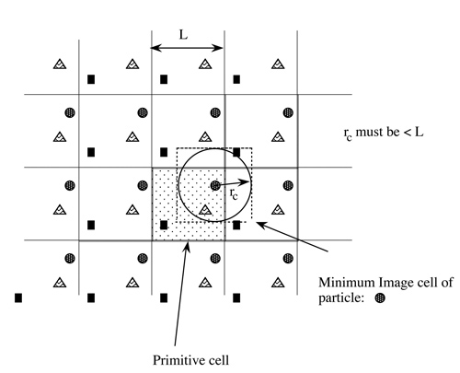

Problem breakdown & CUDA mapping…
The problem is broken down into the following modules with multiple __global__ kernel
Min image convention: On right, one can see how one unit/primitive cell is replicated in all directions in order to simulate bulk phenomenon. This are called periodic boundary conditions. With these in place if an atom/particle leaves from one edge of the unit cell it will enter from the opposite side of the cell.
Force/Energy Calculations: After applying Min image convention, we get the position of nearest neighbors of all the atoms. Potential Energy is then given by $V\left(r\right)=4∗\left(\frac{1}{r^{12}}−\frac{1}{r^{6}}\right)$ while force is calculated using $F={−∇}_{r}V$. Again this is calculated for each pair for an atom and then summed over all neighbors to get net force acting on each atom.
Kinematics: Once, net force on an atom is known acceleration of the atom can be calculated as $a=\frac{F}{m}$. Using this we integrate in time according to Newton’s equations of motion to get the trajectory of all the atoms.
In fig: Min distance between square particle and circle particle is the blue arrow and not the red one.
Min distance kernel: Calculates the min distance between two atoms considering all images of one atom in all directions. Involves one distance computation per pair of atoms
The idea is that the forces will act in a way so as to minimize the total energy of the system and hence reach equilibrium after certain time.

Slide 4
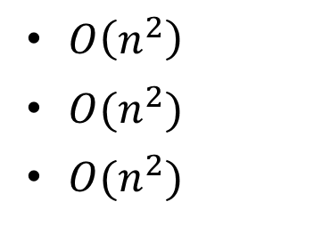
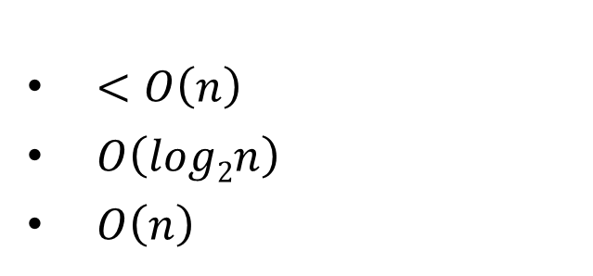
Runtime Complexity of CUDA kernels vs serial code…
Module
Min distance (min image convention)
Energy calculations
Force calculations
Serial Code
Complexity when parallelized
$<O\left(n\right)$
$O\left(log2n\right)$
$O\left(n\right)$
$O\left(n^{2}\right)$
$O(n^{2})$
$O(n^{2})$
All these are separate modules of a serial algorithm each of which can be parallelized
Moreover, we can have parallel kernel launches for force and energy calculations

Slide 5
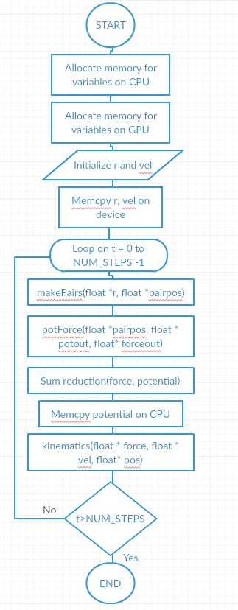
Control Flow Graph of main()
Velocity initialized for every atom using the Boltzmann distribution function
Data structure designed to aid coalesced memory access – data grouped by coordinate for all the atoms stored in contiguous memory locations
Shared memory used to reduce global memory reads
Register variables used to store local variables. Single precision intrinsic operations used to speed up computations.
Reduction kernel used to compute sum of Potential

Slide 6
Performance Analysis of CUDA code…

Slide 7
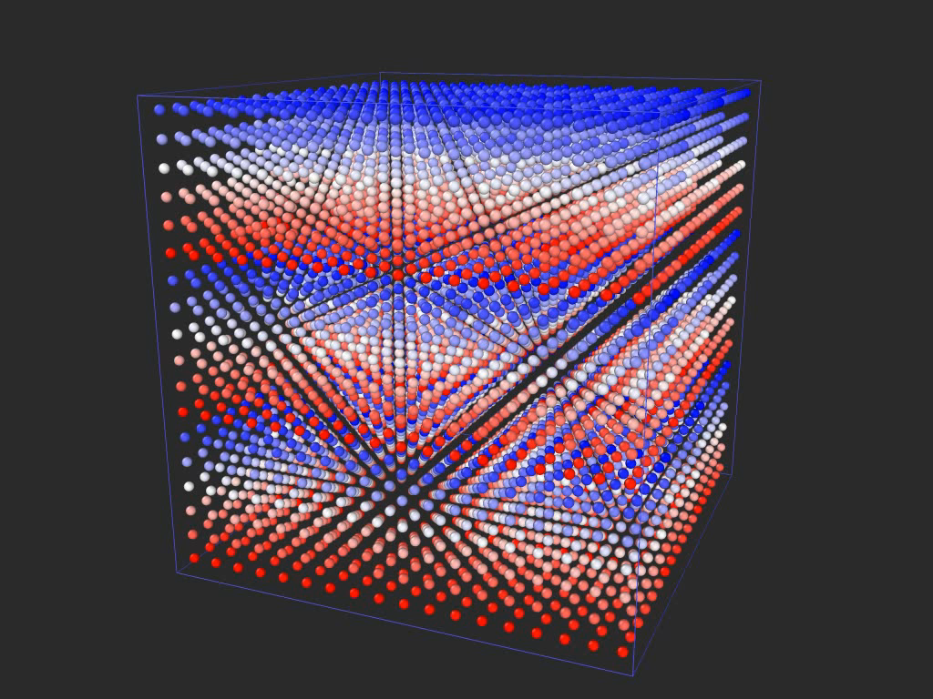
Simulation results
Simulation represents Argon
# Number of atoms – 216
# Temperature – 300 K
9 periodic images rendered for this video

Slide 8
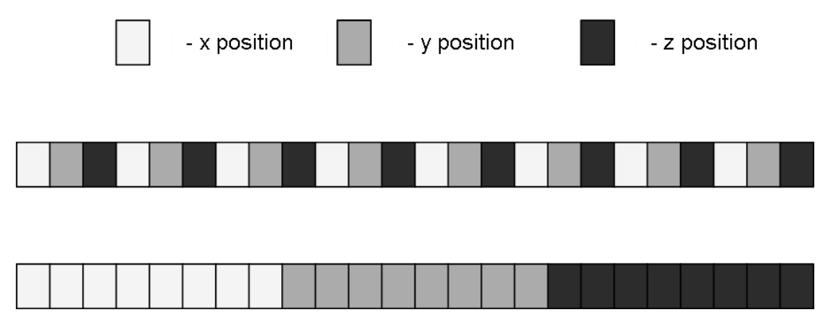
Optimizations performed in CUDA code…
Implicit scheme coded – 0.01 s from 0.0001 s
Force reduction kernel made with complete unrolling but still only par with simple force sum and coalesced memory access – due to low number of additions
Coalesced memory access – Data was stored in a way that allowed for coalesced memory access across all the kernels
Shared memory used to keep global memory reads as low as possible
Single precision intrinsic functions used to compute potential and force for all the atoms to gain speedup in floating point operations
Reduction kernels used throughout to compute sums
Registers have been used to store frequently used local variables
In fig – Data Structure design to aid memory coalescing

Slide 9
THANK YOU!

